Slide 1
05: ARRAY
Programming Technique I
(SCSJ1013)

Slide 2
Array
Contents:
Introduction
Array Declaration
Memory Layout
Terminology
Accessing Array Elements
Array Initialization
Processing Array Contents
Array Assignment
Arrays as Function Arguments
Two-Dimensional Arrays
Array of Strings

Slide 3
Introduction
Array: variable that can store a collection of data of the same type
Examples: A list of names, A list of temperatures
Why do we need arrays?
Imagine keeping track of 5 test scores, or 100, or 1000 in memory
How would you name all the variables?
How would you process each of the variables?

Slide 4
Declaring an Array
An array, named test, containing five variables of type int can be declared as
int tests[5];
The value in brackets is called
A subscript
An index

Slide 5
Array - Memory Layout
The definition:
int tests[5];
allocates the following memory:
first element | second element | third element | fourth element | fifth element

Slide 6
Array Terminology
In the definition int tests[5];
int is the data type of the array elements
tests is the name of the array
5, in [5], is the size declarator. It shows the number of elements in the array.

Slide 7
Array Terminology
The size of an array is:
the total number of bytes allocated for it
(number of elements) * (number of bytes for each element)
Examples:
int tests[5] is an array of 20 bytes, assuming 4 bytes for an int
long double measures[10] is an array of 80 bytes, assuming 8 bytes for a long double

Slide 8
Size Declarators
Named constants are commonly used as size declarators.
const int SIZE = 5; int tests[SIZE];
This eases program maintenance when the size of the array needs to be changed.

Slide 9
Accessing Array Elements
Each element in an array is assigned a unique subscript.
Subscripts start at 0
subscripts:
0 | 1 | 2 | 3 | 4

Slide 10
Accessing Array Elements
The last element’s subscript is n-1 where n is the number of elements in the array.
subscripts:
0 | 1 | 2 | 3 | 4

Slide 11
Accessing Array Elements
Array elements can be used as regular variables:
tests[0] = 79;
cout << tests[0];
cin >> tests[1];
tests[4] = tests[0] + tests[1];
Arrays must be accessed via individual elements:
cout << tests; // not legal

Slide 12
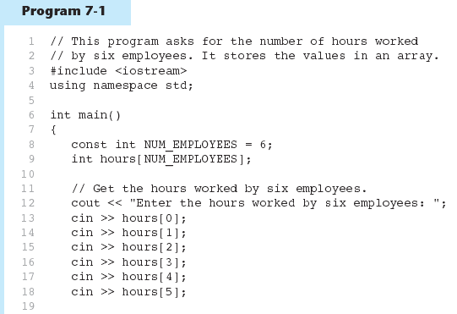
Accessing Array Elements - example
(Program Continues)

Slide 13
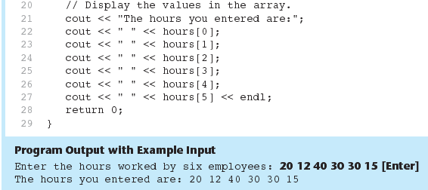
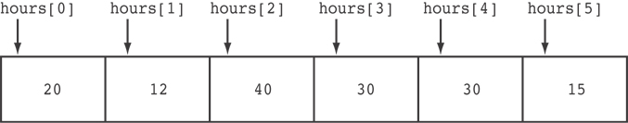
Accessing Array Elements - example
Here are the contents of the hours array, with the values entered by the user in the example output:

Slide 14
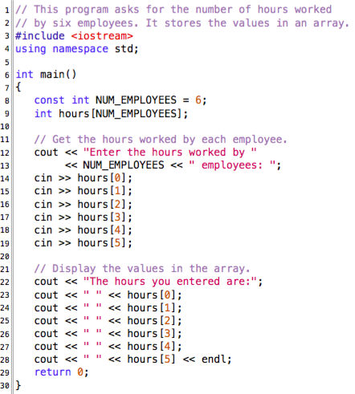
In-class Exercise; Program 7-1
Type the code, compile and run.

Slide 15
Accessing Array Contents
Can access element with a constant or literal subscript:
cout << tests[3] << endl;
Can use integer expression as subscript:
int i = 5;
cout << tests[i] << endl;

Slide 16
Using a Loop to Step Through an Array
Example – The following code defines an array, numbers, and assigns 99 to each element:
const int ARRAY_SIZE = 5;
int numbers[ARRAY_SIZE];
for (int count = 0; count < ARRAY_SIZE; count++)
numbers[count] = 99;

Slide 17
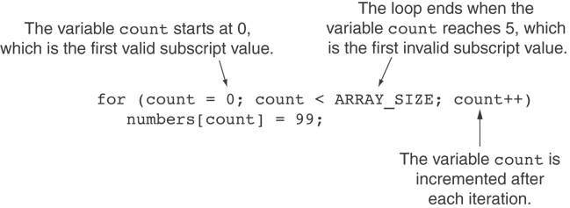
A Closer Look At the Loop

Slide 18
Default Initialization
Global array → all elements initialized to 0 by default
Local array → all elements uninitialized by default

Slide 19
No Bounds Checking in C++
When you use a value as an array subscript, C++ does not check it to make sure it is a valid subscript.
In other words, you can use subscripts that are beyond the bounds of the array.

Slide 20
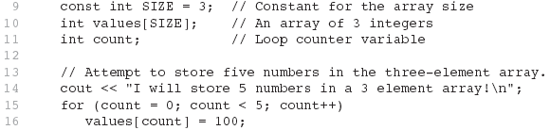
Example
The following code defines a three-element array, and then writes five values to it!

Slide 21
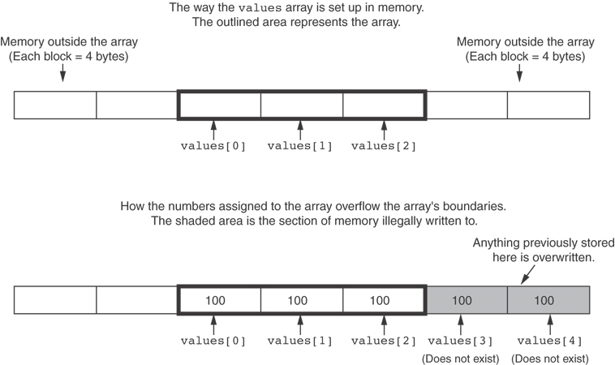
What the Code Does

Slide 22
No Bounds Checking in C++
Be careful not to use invalid subscripts.
Doing so can corrupt other memory locations, crash program, or lock up computer, and cause elusive bugs.

Slide 23
Array Initialization
Arrays can be initialized with an initialization list: const int SIZE = 5; int tests[SIZE] = {79,82,91,77,84};
The values are stored in the array in the order in which they appear in the list.
The initialization list cannot exceed the array size.

Slide 24
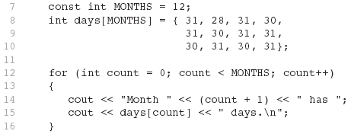
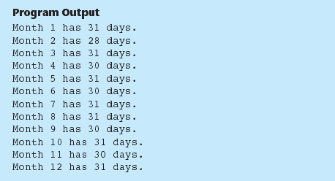
Example

Slide 25
Array Initialization
Valid
int tests[3] = { 3, 5, 11 };
Invalid
int tests[3];
tests = { 3, 5, 11 };

Slide 26
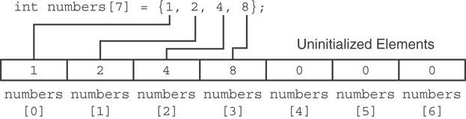
Partial Array Initialization
If array is initialized with fewer initial values than the size declarator, the remaining elements will be set to 0:

Slide 27
Implicit Array Sizing
Can determine array size by the size of the initialization list:
int quizzes[]={12,17,15,11};
Must use either array size declarator or initialization list at array definition
12 | 17 | 15 | 11

Slide 28
Initializing With a String
Character array can be initialized by enclosing string in " ":
const int SIZE = 6; char fName[SIZE] = "Henry";
Must leave room for \0 at end of array
If initializing character-by-character, must add in \0 explicitly:
char fName[SIZE] =
{ 'H', 'e', 'n', 'r', 'y', '\0'};

Slide 29
In-class Exercise; Program 5-1 ( Task # 1)
#include <iostream>
using namespace std;
int main()
{ double a[3];
a[2] = 55.55;
a[0] = 11.11;
a[1] = 33.33;
cout << "a[0] = " << a[0] << endl;
cout << "a[1] = " << a[1] << endl;
cout << "a[2] = " << a[2] << endl;
return 0;
}
Type the above code, compile and run.

Slide 30
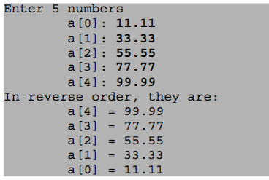
In-class Exercise; Program 5-1 ( Task # 2)
Modify the Program 5-1 so that each input is prompted and each output is labeled, like below:

Slide 31
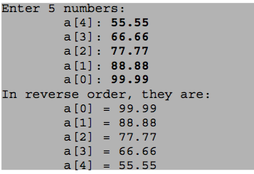
In-class Exercise; Program 5-1 ( Task # 3)
Modify the Program 5-1 so that each input is prompted in reverse and then prints them in the order that they are stored, like this:

Slide 32

Pause :: part #2

Slide 33
Processing Array Contents

Slide 34
Processing Array Contents
Array elements can be treated as ordinary variables of the same type
When using ++, -- operators, don’t confuse the element with the subscript:
tests[i]++; // add 1 to tests[i]
tests[i++]; // increment i, no
// effect on tests

Slide 35
Array Assignment
To copy one array to another,
Don’t try to assign one array to the other:
newTests = tests; // Won't work
Instead, assign element-by-element:
for (i = 0; i < ARRAY_SIZE; i++)
newTests[i] = tests[i];

Slide 36
Printing the Contents of an Array
You can display the contents of a character array by sending its name to cout: char fName[] = "Henry";
cout << fName << endl;
But, this ONLY works with character arrays!

Slide 37
Printing the Contents of an Array
For other types of arrays, you must print element-by-element:
for (i = 0; i < ARRAY_SIZE; i++)
cout << tests[i] << endl;

Slide 38
Summing and Averaging Array Elements
Use a simple loop to add together array elements:
int tnum;
double average, sum = 0;
for(tnum = 0; tnum < SIZE; tnum++)
sum += tests[tnum];
Once summed, can compute average:
average = sum / SIZE;

Slide 39
Finding the Highest Value in an Array
int count;
int highest;
highest = numbers[0];
for (count = 1; count < SIZE; count++)
{
if (numbers[count] > highest)
highest = numbers[count];
}
When this code is finished, the highest variable will contain the highest value in the numbers array.

Slide 40
Finding the Lowest Value in an Array
int count;
int lowest;
lowest = numbers[0];
for (count = 1; count < SIZE; count++)
{
if (numbers[count] < lowest)
lowest = numbers[count];
}
When this code is finished, the lowest variable will contain the lowest value in the numbers array.

Slide 41
Comparing Arrays
To compare two arrays, you must compare element-by-element:
const int SIZE = 5;
int firstArray[SIZE] = { 5, 10, 15, 20, 25 };
int secondArray[SIZE] = { 5, 10, 15, 20, 25 };
bool arraysEqual = true; // Flag variable
int count = 0; // Loop counter variable
continues ...

Slide 42
Comparing Arrays
To compare two arrays, you must compare element-by-element:
// Compare the two arrays.
while (arraysEqual && count < SIZE)
{
if (firstArray[count] != secondArray[count])
arraysEqual = false;
count++;
}
if (arraysEqual)
cout << "The arrays are equal.\n";
else
cout << "The arrays are not equal.\n";

Slide 43
Using Parallel Array

Slide 44
Using Parallel Arrays
Parallel arrays: ….two or more arrays that contain related data
A subscript is used to relate arrays: ….elements at same subscript are related
Arrays may be of different types

Slide 45
Parallel Array Example
const int SIZE = 5; // Array size
int id[SIZE]; // student ID
double average[SIZE]; // course average
char grade[SIZE]; // course grade
...
for(int i = 0; i < SIZE; i++) {
cout << "Student ID: " << id[i]
<< " average: " << average[i]
<< " grade: " << grade[i]
<< endl; }

Slide 46
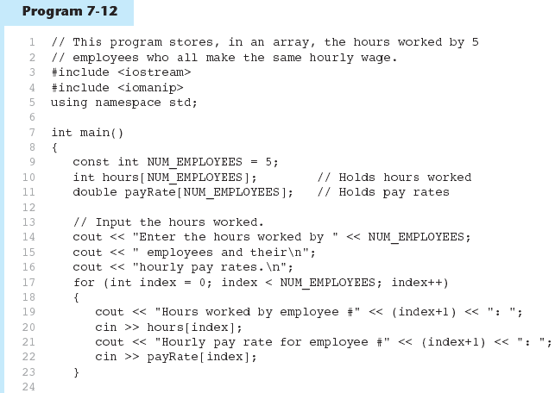
Parallel Array Example
(Program Continues)

Slide 47
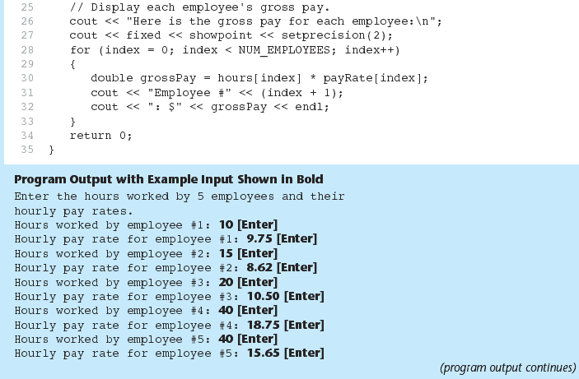
Parallel Array Example
Program 7-12 (Continued)

Slide 48
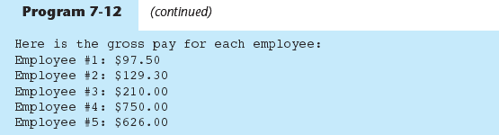
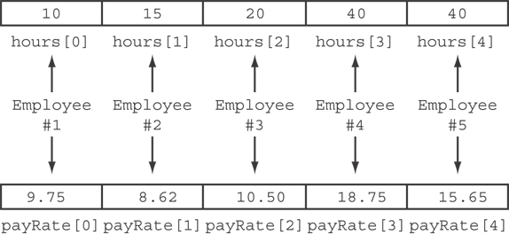
Parallel Array Example
The hours and payRate arrays are related through their subscripts:

Slide 49
Array as Function Arguments

Slide 50
Arrays as Function Arguments
To pass an array to a function, just use the array name:
showScores(tests);
To define a function that takes an array parameter, use empty [] for array argument:
// function prototype
void showScores(int []);
// function header
void showScores(int tests[])

Slide 51
Arrays as Function Arguments
When passing an array to a function, it is common to pass array size so that function knows how many elements to process:
showScores(tests, ARRAY_SIZE);
Array size must also be reflected in prototype, header:
// function prototype
void showScores(int [], int);
// function header
void showScores(int tests[], int size)

Slide 52
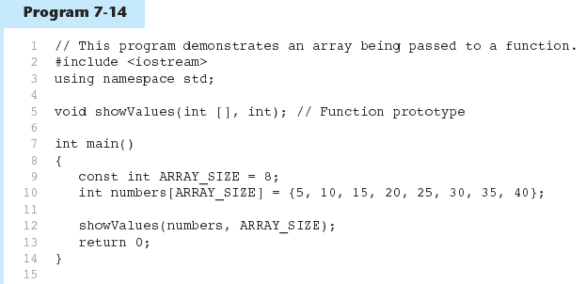
Arrays as Function Arguments - Example
(Program Continues)

Slide 53
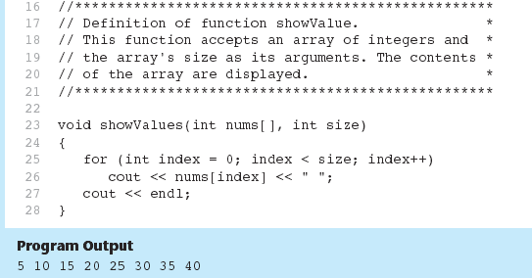
Arrays as Function Arguments - Example
Program 7-14 (Continued)

Slide 54
Modifying Arrays in Functions
Array names in function’s parameters are like reference variables;
changes made to array in a function are reflected in actual array in calling function
Need to exercise caution that array is not accidentally changed by a function

Slide 55
In-Class Exercise - 5.1
The following program skeleton, when completed, will ask the user to enter 10 integers which are stored in an array.
The function avgArray (which you must write/code), is to calculate and return the average of the numbers entered.
#include <iostream>
//Write your function prototype here
int main() {
const int SIZE = 10;
int userNums[SIZE];
cout << "Enter 10 numbers: ";
for (int count = 0; count < SIZE; count++){
cout << "#" « (count + 1) << " ";
cin >> userNums[count];
}
cout << "The average of those numbers is ";
cout << avgArray(userNUms, SIZE) << endl;
return 0;
}
//Write the function avgArray here.

Slide 56
In-Class Exercise - 5.2
Write a program that has two overloaded functions that return the average of an array with the following headers:
int average(int array[], int size)
double average(double array[], int size)
Use {1,2,3,4,5,6} and {6.0,4.4,1.9,2.9,3.4,3.5} to test the functions.

Slide 57
In-Class Exercise - 5.3
Write a program that has a function that returns the index of the smallest element in an array of integers. If there are more than one such elements, return the smallest index.
Use {5,2,4,5,10,100,2,22} as array initial values to test the function.

Slide 58
Submission: In-Class Exercise
Submit today exercise, 5.1, 5.2 and 5.3 via elearning.
Upload all three *.cpp files without compression (or without using WinZip or WinRar)

Slide 59
Submission: In-Class Exercise
OR submit via email (if elearning got problem):
ahmadfariz@utm.my
email subject header: “Lab Exercise 5.1, 5.2 & 5.3

Slide 60
Two-Dimensional Array

Slide 61
Two-Dimensional Array
Can define one array for multiple sets of data
Like a table in a spreadsheet
Use two size declarators in definition:
const int ROWS = 4, COLS = 3; int exams[ROWS][COLS];
First declarator is number of rows; second is number of columns

Slide 62
Two-Dimensional Array Representation
const int ROWS = 4, COLS = 3;
int exams[ROWS][COLS];
Use two subscripts to access element:
exams[2][2] = 86;
columns
exams[0][0] | exams[0][1] | exams[0][2]
exams[1][0] | exams[1][1] | exams[1][2]
exams[2][0] | exams[2][1] | exams[2][2]
exams[3][0] | exams[3][1] | exams[3][2]
r
o
w
s

Slide 63
Two-Dimensional Array Initialization
Two-dimensional arrays are initialized row-by-row: const int ROWS = 2, COLS = 2; int exams[ROWS][COLS] = { {84, 78},
{92, 97} };
Can omit inner { }, OR some initial values in a row – array elements without initial values will be set to 0 or NULL
84 | 78
92 | 97

Slide 64
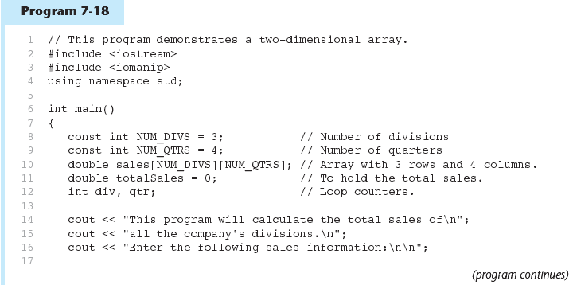
Two-Dimensional Array - Example

Slide 65
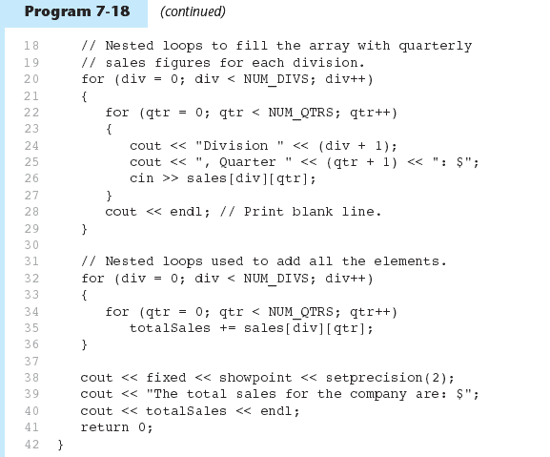
Two-Dimensional Array - Example

Slide 66
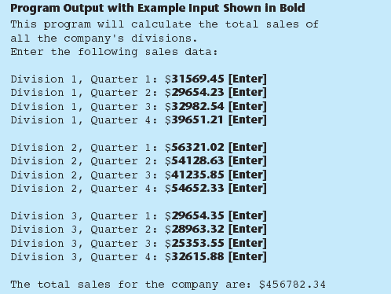
Two-Dimensional Array - Example

Slide 67
Summing All the Elements in a Two-Dimensional Array
Given the following definitions:
const int NUM_ROWS = 5; // Number of rows
const int NUM_COLS = 5; // Number of columns
int total = 0; // Accumulator
int numbers[NUM_ROWS][NUM_COLS] =
{{2, 7, 9, 6, 4},
{6, 1, 8, 9, 4},
{4, 3, 7, 2, 9},
{9, 9, 0, 3, 1},
{6, 2, 7, 4, 1}};

Slide 68
Summing All the Elements in a Two-Dimensional Array
// Sum the array elements.
for (int row = 0; row < NUM_ROWS; row++)
{
for (int col = 0; col < NUM_COLS; col++)
total += numbers[row][col];
}
// Display the sum.
cout << "The total is " << total << endl;

Slide 69
Summing the Rows of a Two-Dimensional Array
Given the following definitions:
const int NUM_STUDENTS = 3;
const int NUM_SCORES = 5;
double total; // Accumulator
double average; // To hold average scores
double scores[NUM_STUDENTS][NUM_SCORES] =
{{88, 97, 79, 86, 94},
{86, 91, 78, 79, 84},
{82, 73, 77, 82, 89}};

Slide 70
Summing the Rows of a Two-Dimensional Array
// Get each student's average score.
for (int row = 0; row < NUM_STUDENTS; row++)
{
// Set the accumulator.
total = 0;
// Sum a row.
for (int col = 0; col < NUM_SCORES; col++)
total += scores[row][col];
// Get the average
average = total / NUM_SCORES;
// Display the average.
cout << "Score average for student "
<< (row + 1) << " is " << average <<endl;
}

Slide 71
Summing the Columns of a Two-Dimensional Array
Given the following definitions:
const int NUM_STUDENTS = 3;
const int NUM_SCORES = 5;
double total; // Accumulator
double average; // To hold average scores
double scores[NUM_STUDENTS][NUM_SCORES] =
{{88, 97, 79, 86, 94},
{86, 91, 78, 79, 84},
{82, 73, 77, 82, 89}};

Slide 72
Summing the Columns of a Two-Dimensional Array
// Get the class average for each score.
for (int col = 0; col < NUM_SCORES; col++)
{
// Reset the accumulator.
total = 0;
// Sum a column
for (int row = 0; row < NUM_STUDENTS; row++)
total += scores[row][col];
// Get the average
average = total / NUM_STUDENTS;
// Display the class average.
cout << "Class average for test " << (col + 1)
<< " is " << average << endl;
}

Slide 73
In-Class Exercise - 5.4
modify the Program 7-18 so that it will display the total sales for the 3rd quarter for all division. Below is an example output:
This program will calculate the total sales of
all the company's divisions.
Enter the following sales information:
Division 1, Quarter 1: $31569.45
Division 1, Quarter 2: $29654.23
Division 1, Quarter 3: $32982.54
Division 1, Quarter 4: $39651.21
Division 2, Quarter 1: $56321.02
Division 2, Quarter 2: $54128.63
Division 2, Quarter 3: $41235.85
Division 2, Quarter 4: $54652.33
Division 3, Quarter 1: $29654.35
Division 3, Quarter 2: $28963.32
Division 3, Quarter 3: $25353.55
Division 3, Quarter 4: $32615.88
The total sales for the 3rd quarter is: $99571.94

Slide 74
Two-Dimensional Array as Parameter, Argument
Use array name as argument in function call:
getExams(exams, 2);
Use empty [] for row, size declarator for column in prototype, header:
const int COLS = 2; // Prototype void getExams(int [][COLS], int); // Header void getExams(int exams[][COLS], int rows)

Slide 75
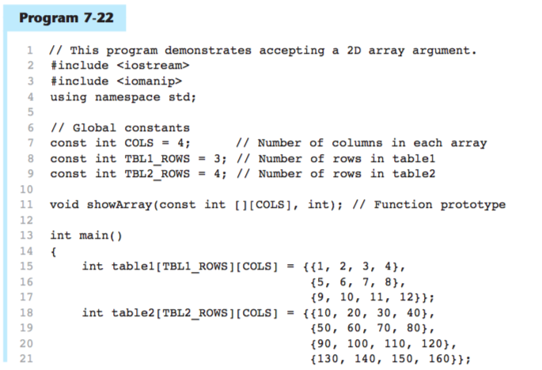
Example: Array in function call

Slide 76
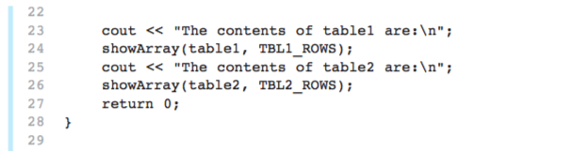
Example: Array in function call

Slide 77
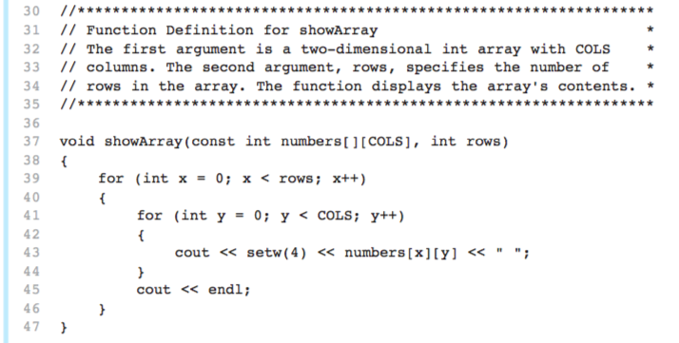
The showArray Function

Slide 78
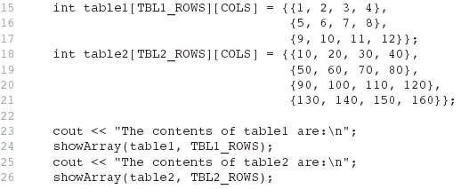
How showArray is Called

Slide 79
In-Class Exercise - 5.5
modify the previous program, i.e. Program 7-22, by creating another function that will sum all the elements for table1 and table2 and print the result.
the expected output as shown below:
The sum of all elements for table1 is: 78
The sum of all elements for table2 is: 1360

Slide 80
Array of Strings
Use a two-dimensional array of characters as an array of strings:
const int NAMES = 3, SIZE = 10; char students[NAMES][SIZE] = {"Ann", "Bill", ……………… -- ----------------------"Cindy" };
Each row contains one string
Can use row subscript to reference the string in a particular row:
cout << students[i];

Slide 81
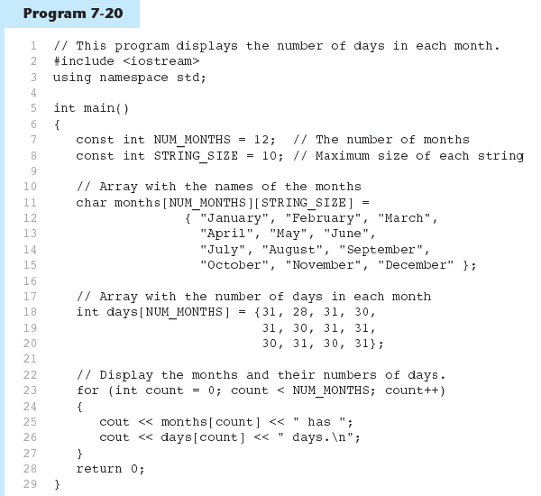
Array of Strings - Example

Slide 82
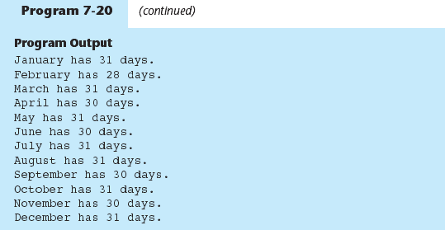
Array of Strings - Example

Slide 83
Arrays with Three or More Dimensions
Can define arrays with any number of dimensions:
short rectSolid[2][3][5];
double timeGrid[3][4][3][4];
When used as parameter, specify all except 1st dimension in prototype, heading:
void getRectSolid(short [][3][5]);

Slide 84
In-Class Exercise - 5.6
Write a complete program that stores the following number of medal collection for 4 countries into the 2-D array called medals.
 | Gold | Silver | Bronze
Country 1 | 129 | 257 | 590
Country 2 | 120 | 279 | 394
Country 3 | 115 | 290 | 123
Country 4 | 98 | 209 | 112

Slide 85
In-Class Exercise - 5.6 (cont.)
Your program must have the following functions that do the following:
Read the number of medal for each country from a keyboard and store them inside the medals array.
Return total number of medals won by any country.
Return the largest number of medals won.
Return the smallest number of medals won.
Return the highest number of gold medal won.
Return the total number of bronze medal won by any country.

Slide 86
Submission: In-Class Exercise
Submit today exercise, i.e. 5.4, 5.5, and 5.6 via elearning.
Upload all the *.cpp files without compression (or without using WinZip or WinRar)

